Slide 1



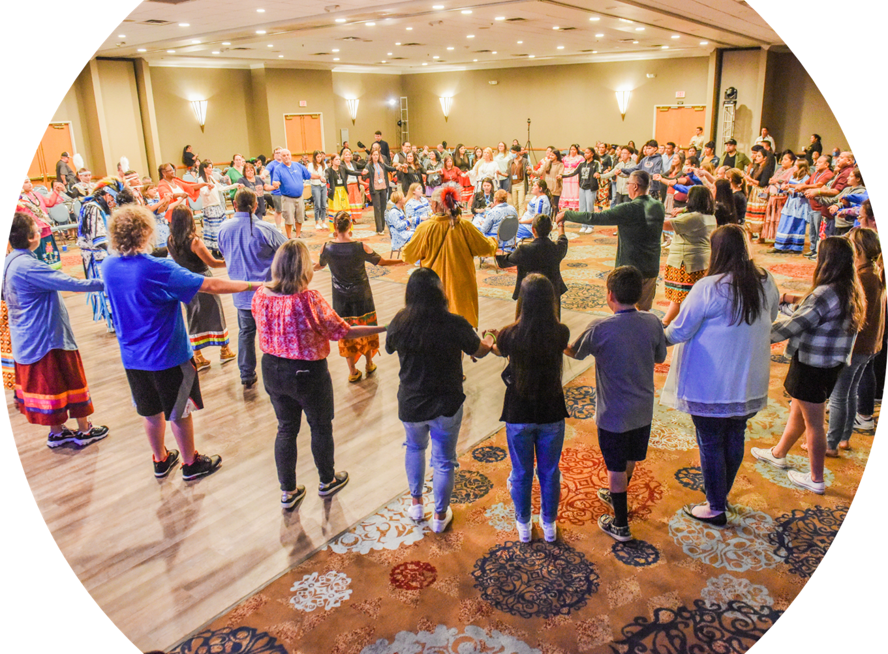

Welcome!
©NCAI 2023
Notes:
Norma ​
​Housekeeping ​
​Turn over to BGCA NVP Native Services Carla Knapp​
​

Slide 2

T.R.A.I.L. 2023-2024 Overview Training
October, 2023
Notes:
Carla​
​
Thank you Norma and welcome everyone to our second training TRAIL 2023 Program Data Tracking and Reporting.......we hope that you enjoy the next 60 minutes together and find the informational valuable as you begin to implement your TRAIL program. ​
​
Next slide....
​

Slide 3





National Partners
©NCAI 2023
Notes:
Carla​
​
And before we begin, I want to acknowledge and recognized our amazing partners......through the support of Indian Health Services, BGCA and NCAI have partnered directly together to support you and your TRAIL program.​ I can't stress enough how excited we truly are and look forward to an amazing year and working with you in partnership.​
​I also hope that some of the changes we have made will make this easier for you and very streamlined.
So lets get this started.......it is an honor and a privilege to introduce our first presenter......Please welcome our very own, BGCA Native Services Director of Organizational Development Anna Bear to take more about the curriculum.

Slide 4
Training Objectives
©NCAI 2023
To understand the framework and purpose of T.R.A.I.L.​
  Curriculum and Implementation​
  Progress Reports​
  Physical Activity Logs​
  Pre- and Post-tests​
To network, make connections, and learn from each other
Notes:
Lisa
Thank you Carla ​
The training objectives for today are ​
To understand the framework and purpose of T.R.A.I.L.​
Curriculum and Implementation​
Progress Reports​
Physical Activity Logs​
Pre- and Post-tests​
Physical Activity Challenge Tracking​
Implementation Plans (New)​
To network, make connections, and learn from each other

Slide 5

T.R.A.I.L. Curriculum
©NCAI 2023
Notes:
Lisa
Now we will discuss the TRAIL Curriculum

Slide 6

HELPFUL TIPS
©NCAI 2023
Program staff need to read through the curriculum before beginning implementation​
​
Plan ahead to know what materials will be needed for each chapter​
​
The curriculum is only 12 weeks; remember there are additional program requirements detailed in the LOA​
​
Curriculum is written for a target audience of Native youth ages 7-11
Notes:
Lisa
Here are some items that are extremely helpful before TRAIL implementation​
​
In advance, I cannot stress this enough. ​
IN ADVANCE​
Read the curriculum, ​
Review the materials, ​
Review the links ​
Review the additional program requirements ​
And have an understanding how each individual chapter is supposed to be implemented ​
Practice
If you need to...reach out to others who have the TRAIL program if you need help ​
This could also mean making copies, arranging for guest speakers, buying materials, preparing the space or whatever is needed to make sure the implementation is smooth, fun and engaging for maximum impact ​
​
Again, staff should give themselves plenty of time before beginning implementation in order to plan and to be well prepared​
​
Also keep in mind, as a recipient of the TRAIL program, you must serve the number of Native youth ages 7-11 outlined in your LOA. ​
However, you are welcome to provide the curriculum to more youth and adapt for other age ranges once you have met the minimum requirement.

Slide 7
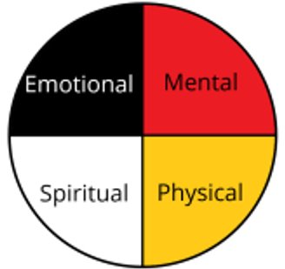
The Whole Healthy Person
©NCAI 2023
Notes:
Anna​
The T.R.A.I.L. program has incorporated the Circle of Life throughout its curriculum. ​
Throughout the chapters of the T.R.A.I.L. we are guided by the balance of a whole healthy person physically, spiritually, emotionally and mentally​
​
Integrating the Circle concept and its related symbolism will help our Native youth succeed in all aspects of creating and sustaining a healthy body and a positive sense of well-being.​
​

Slide 8
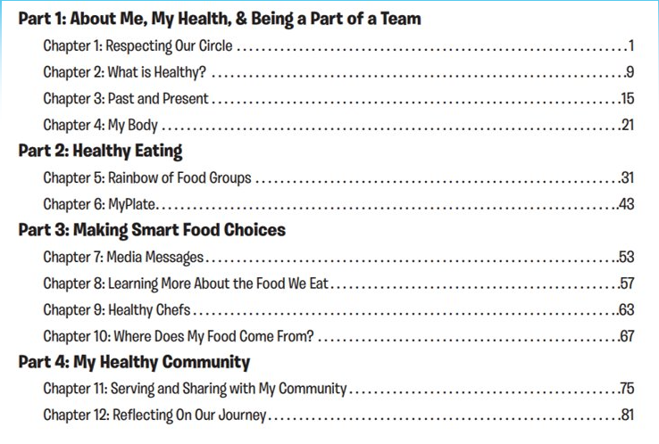
©NCAI 2023
Notes:
Anna​
Each of these four components build upon each other to form a comprehensive, balanced understanding of type 2 diabetes prevention. ​
​
The four primary components are: ​
1. About Me, My Health, & Being a Part of a Team​
2. Healthy Eating ​
3. Making Smart Food Choices ​
4. My Healthy Community ​
Throughout the chapters, participants will experience several different ways of how to be a whole healthy person Physically, Spiritually, Emotionally and Mentally ​
​

Slide 9

What Makes up a Chapter?
©NCAI 2023
Lesson Objectives​
Review of last chapter ​
Helpful Hints​
Lessons & Activities ​
Talking Circles​
Optional Activities​
Behavioral Health ​
Healthy recipes
Notes:
Anna​
With all that in mind this is what each chapter of the curriculum will contain:​
Lesson Objectives​
Helpful Hints​
Review of last chapter​
Lessons & Activities ​
Talking Circles​
Optional Activities​
Behavioral Health ​
Healthy recipes​
Cultural Adaptations​
Physical Activity Challenges

Slide 10

©NCAI 2023
Enhancing T.R.A.I.L.
Cultural Adaptations
Notes:
Lisa
A huge way to enhance your TRAIL program is to consider ways to infuse culture in all ways ​
Maybe it is a blessing over each session or over food and those who prepared ​
Maybe it is indigenous foods ​
There are so many ways we can use culture to make TRAIL our own in our respective communities

Slide 11
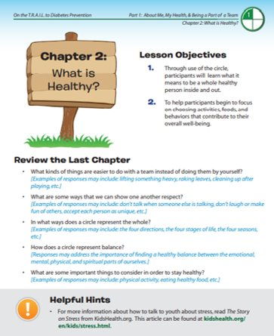
©NCAI 2023
Notes:
Lisa
Here is snapshot of what you will see...​
This is chapter 2 from the TRAIL Curriculum ​​
Keep in mind, the chapters do not come to life when staff just pick up the book and read word for word, ​ The TRAIL experience, like all club programs, is meant to be fun, engaging and meaningful so youth are equipped to make healthy decisions in regard to Diabetes Prevention ​We want youth to connect to the curriculum so they understand ways they can be healthy ​which is why we discussed how to prepare in advance and the importance of it ​
Here you will see ​
Lesson Objectives​
Review the Last Chapter ​
Helpful Hints​
You will also see links and resources sprinkled in the chapter as well​
​

Slide 12
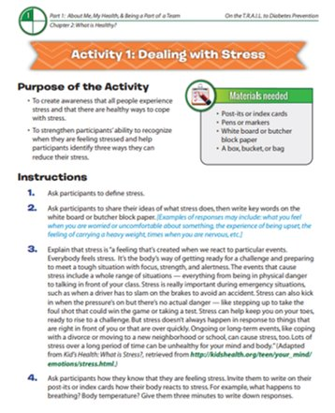
©NCAI 2023
Notes:
Lisa
Read Slide and point out items ​
Lessons & Activities ​
In this little box you also see Material Needed

Slide 13
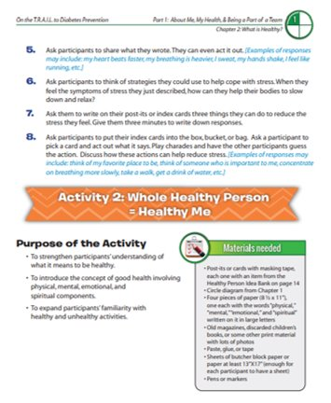
©NCAI 2023
Notes:
Lisa
Read Slide and point out items ​
Lessons & Activities ​
Again Materials Needed

Slide 14
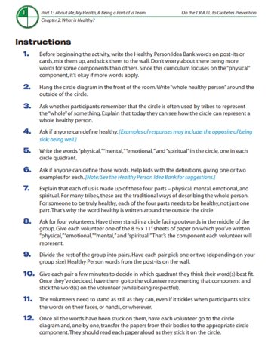
©NCAI 2023
Notes:
Lisa
Read Slide and point out items ​
Lessons & Activities

Slide 15
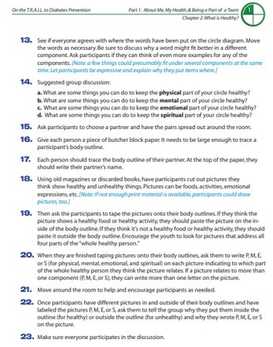
©NCAI 2023
Notes:
Lisa ​
Read Slide and point out items

Slide 16
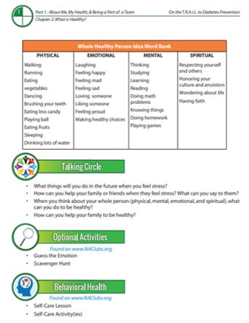
©NCAI 2023
Notes:
Read Slide and point out items ​
Talking Circles​
Optional Activities​
Behavioral Health ​
Healthy recipes

Slide 17

©NCAI 2023
Physical Activity Challenge
Notes:
Anna ​
This is not to be confused with The Daily Physical Activity Requirement that we will discuss later in the slides ​
​
While the T.R.A.I.L. program seeks to help youth improve in physical activity as well as nutrition, ​
we recognize that not all youth can participate in the traditional T.R.A.I.L. physical activity challenges.​
​
Therefore, we would like to incorporate new activities to allow all youth to participate, despite their beginning level of fitness or physical ability.​
​
BGCA plans to submit suggestions to IHS to change what the Physical Activity Challenges can be so that you can provide a more inclusive and relevant activity component for T.R.A.I.L. ​
​
This is where we need your help ​
​
Based on your experience running the T.R.A.I.L. program at your site, we would love your feedback!​
​
You will receive an email that will ask you for feedback in regard to the physical activity challenges and a few other items that we will discuss in this presentation ​
​
We ask that you please send the feedback back to us by no later than February 7th, 2023​
​
​
​
​
​

Slide 18
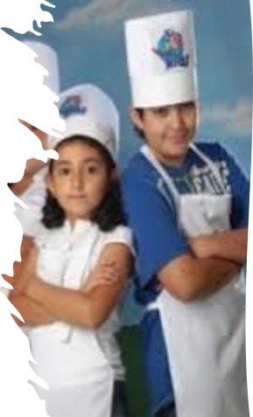
©NCAI 2023
Healthy Snack Demonstrations
Each round of curriculum implementation​
must have 2 healthy snack demonstrations​
Must be hands on with the participants​
All food items must be T.R.A.I.L. Appropriate​
Tips:​
  Try easy recipes participants can make at home​
  Use locally available/affordable ingredients​
Notes:
Anna​
Check out these awesome chefs! ​
This is one of my favorite parts of TRAIL although I do love all of the curriculum ​
THE HEALTHY SNACK DEMONSTRATION!!!! ​
How fun is this!?!​​
Things to know about this is​​
Each round of curriculum implementation must have 2 healthy snack demonstrations​
It must be hands on with the participants​
All food items must be T.R.A.I.L. appropriate​
Tips:​
Try easy recipes participants can make at home​
Use locally available/affordable ingredients​
Indigenous foods​
Involve Community Members​
Elders ​
Tribal Departments ​
Maybe kids could gather berries to use them in a cool smoothie recipe​
​The possibilities are endless!

Slide 19

©NCAI 2023
Community Education Project
Introduction to this project begins in Chapter 6​
Required as part of Chapter 11​
Project Requirements:​
  Must be youth-led​
  Must be based around youth sharing T.R.A.I.L. healthy lifestyle lessons with community
  members​
Tips:​
  Get creative​
  Involve a partner organization
Notes:
Anna​
In Chapter 6 the Community Education Project will be introduced to participants ​
This will be brainstorming "How can we help make our whole community be as healthy as possible"​
annnnnnnnd ​
the participants will host a Community Education Project in Chapter 11!​
You will use that time between chapter 6 to chapter 11 to plan and organize the project.​
​
The community education project should be an educational activity that betters our communiity by sharing information and/or hosting activities related to health, wellness, and type 2 diabetes prevention. But don’t forget it is engaging!​
​
If possible, the community education project should take place at a location other than the Club. ​
​
Also , the community education project only needs to be implemented once per grant year for each unit, ​
even if they run the TRAIL curriculum more than once in a grant period​

Slide 20
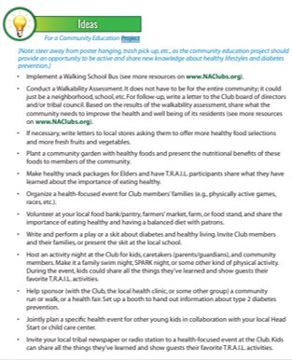
©NCAI 2023
Make healthy snack packages for elders ​
Plant a community garden ​​
Volunteer at a food bank ​​
Partner to host a health fair ​​
Help write a T.R.A.I.L. article for the tribal newspaper ​​
Make a diabetes prevention video that will be featured on your clubs social media ​
Notes:
Here are some ideas that have been given in the curriculum ​
​
Make healthy snack packages for elders
Plant a community garden
Volunteer at a food bank
Partner to host a health fair
Help write a T.R.A.I.L. article for the tribal newspaper
Make a diabetes prevention video that will be featured on your clubs social media

Slide 21

©NCAI 2023
Community Education Project Club Share Out
Notes:
Now, ​
Those were some great ideas,​
BUT I am gonna take it to the experts...YOU!​
You awesome clubs have hosted some amazing community education projects or have some ideas for new ones.​
​
Please type in the chat what are some ideas you all have for Community Education Projects

Slide 22

©NCAI 2023
HEALTHY FOODS
FOR HEALTHY LIFESTYLES
Notes:
Anna

Slide 23
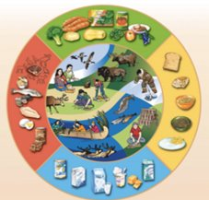
©NCAI 2023
Why do healthy food choices matter?
The T.R.A.I.L. program’s goal is to prevent the onset of type 2 diabetes and healthy food choices ​
Healthy food choices promote health and wellness to youth​
Healthy, nutritious food helps gives the energy needed to do physical activity​​
Notes:
Anna
Healthy food choices help with diabetes prevention in a huge way and contributes to being a whole healthy person physically, spiritually, emotionally and mentally. ​
​
The T.R.A.I.L. program’s goal is to prevent the onset of type 2 diabetes ​
and healthy food choices are a very important part of diabetes prevention​
Healthy food choices promote health and wellness to youth​
And Healthy, nutritious food helps give youth the energy needed to do physical activity​
​
Think about a time when you ate something healthy or drank water and how much it helped contribute to your well-being physically, spiritually, emotionally or mentally.​
​
Some may not have been hangry, some of you felt physically better, some of you felt they could concentrate or that they had more energy. this is the same for our youth. ​
With this in mind it is very important to understand that foods that do not support diabetes prevention or are not TRAIL appropriate cannot be reimbursed with T.R.A.I.L. grant funds ​
​

Slide 24
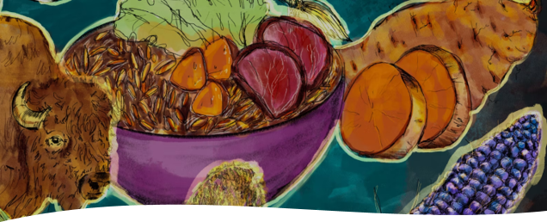
©NCAI 2023
Tips for Healthy Snack Choices​
  Fresh is best​
  Make a list​
  A balanced diet = healthy diet​
  Natural/organic does not always mean healthy​
and T.R.A.I.L. appropriate​
  If in doubt, ask ​
Healthy Snacks Guidance resource​
Budgeting for healthy eating
Incorporating
Healthy Snacks
Notes:
Anna
Now let's talk about how we can incorporate healthy snacks​
​
Here are some tips to assist with making Healthy Snack Choices​
Fresh is best​
Make a list so you can be prepared ​
A balanced diet = healthy diet​
Keep in mind that Natural/organic does not always mean healthy and T.R.A.I.L. appropriate​
If in doubt, ask (well in advance)​
You will receive a Healthy Snacks Guidance resource to help you ​
Budgeting for healthy eating​
​
Pre-Planning and Communication are huge pieces of the success for incorporating healthy snacks ​
​
You could develop menu's and prepare notes to explain the reason why you need to purchase a particular food and have a discussion for pre-approval as well ​
​
Communication is key

Slide 25
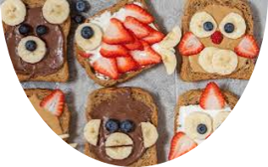

©NCAI 2023
Getting Youth Interested in healthy foods
How to help:​
​
Mix things up - disguise healthy foods as more enjoyable choices​
​
Tie foods back to local history or connections​
​
Make snack time fun -involve youth and create games around healthy eating
Notes:
Anna
Here are some ways to help get youth interested in healthy food ​
Mix things up – disguise healthy foods as more enjoyable choices​
Tie foods back to local history or connections​
Make snack time fun – involve youth and create games around healthy eating​
Innovation and creativity are definitely key in this space ​
and creating a safe space to just "try" new food without consequence is important as well

Slide 26


©NCAI 2023
Challenges & Best Practices ​
In Securing Healthy Snacks
Notes:
Anna
Let's talk about some challenges and best practices in securing healthy snacks ​
For example, ​
-In previous years we have heard that the distance to secure food and a rise in gas prices may be a challenge to secure healthy snacks ​
-A Challenge could also be that the healthier food option is much more expensive and it is hard to budget​
-A best practice may be working with the community garden to harvest healthy snacks ​
​
I would like to open it up in the chat for any challenges and best practices for securing healthy snacks so that we can learn from one another ​
​
Open up for a chat ​
Questions to pose​
​
How are we using food in our budget?​
What are some challenges?​
What are some opportunities?​
​
Now I would like to turn it back over to Lisa Vandever, who will give some more information to be successful with TRAIL ​

Slide 27

©NCAI 2023
Progress Reports
Due dates:​
  Quarter 1 (Oct-Nov 2023): due from Clubs 1/19/2024​
  Quarter 2 (Jan-March 2024): due from Clubs 4/19/2024
  Quarter 3 (April-June 2024): due from Clubs 7/19/2024
  Quarter 4 (July-Sept 2024): due from Clubs 10/18/2024
  ​
Components and reporting guide​
Submission to Funder (IHS)
Notes:
LISA​
The due dates are as follows:​
Read each bullet.​
We will cover components and reporting guide in the next couple slides.​
All the data collected and requested for the report to IHS​

Slide 28
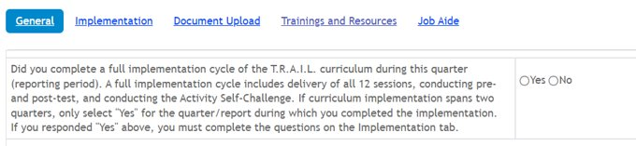
©NCAI 2023
Progress Reports
Your view of the Quarterly Program Report​
All Clubs must complete all questions on the General Tab​
Please only answer questions on the Implementation Tab if you respond “Yes” to the question “Did you complete full implementation cycle of the TRAIL curriculum during this quarter”.
Notes:
When you get into your report for the club site, this is your view of the Quarterly Program Report
All Clubs must complete all questions on the General Tab (highlighted in BLUE at the top of your screen).
At this point, your first question should be answered "yes" to implementation of the entirety (all 12 chapters) of TRAIL at your club. Complete the General information. Please use complete sentences to explain thoroughly. This is a very important piece. We want to know about the events. We want to see your outcomes and gather any feedback. This is where we receive the important information and successes to share with our partners and to know how we can give you your best support.
NEXT SLIDE

Slide 29
©NCAI 2023
Progress Report Sections
Section 1) General questions for all sites​
​
Section 2) Questions about the completion of a curriculum implementation cycle​
​
Clubs will only report on Pre- and Post-tests, Youth demographic data, Physical Activity Challenges on the Progress Report after they have completed the implementation
Notes:
Lisa:​
​
We are making changes to the data tracking and data reporting for T.R.A.I.L. program. ​
The report will mimic the format for the OJJDP Mentoring program. ​
There will be tabs for each section. ​
The first section will be general questions that all sites will complete each quarter. ​
The second tab will only be completed during the reporting period that you complete your T.R.A.I.L. curriculum implementation cycle. ​
​
If your implementation of the T.R.A.I.L. curriculum spans two reporting periods, you will only complete the second tab during the reporting period when the implementation ended.

Slide 30
©NCAI 2023
What has changed?
Youth level data will only be reported in aggregate. Clubs will be required to track data and maintain on file.​
Daily Physical Activity will be tracked in a PA Log spreadsheet and only summary information will be submitted quarterly.​
You will only submit information about the T.R.A.I.L. curriculum implementation during the reporting period when it ended.
Notes:
LISA​
​
We have been looking to update the reports to make them easier to complete. ​
To make sure these changes are in line with the Clubs’ experience, we will be sending the report questions and tracking sheets out to Clubs after this webinar. ​
Please provide your feedback on these by next Tuesday, February 7th to allow us to take the feedback into account prior to developing the new reports. We will explain these documents in the email that goes out, but here are some of the major changes that you will see in the updated report and data tracker.​(We still doing this?)
Youth level data on demographics, pre- and post-test, and physical activity challenges NEED TO BE COLLECTED daily/monthly by each Club BUT will only be reported to BGCA in aggregate. ​
Example: You will report on the number of youth who improved in pre- and post tests., you will not report each youth’s scores.​
You will track Daily Physical Activity in a PA Log spreadsheet and only submit the summary data on a quarterly basis. You will not be submitting monthly physical activity data this year. You will need to maintain the spreadsheet for your files and will be requested during site visits and audits. ​
You will not enter youth data into the system. We have created a data tracking spreadsheet where you can track the youth level demographics, pre- and post-tests, and other data. You will need have the youth level data available during site visits and audits.​
​
​

Slide 31
©NCAI 2023
Physical Activity Logs
The T.R.A.I.L. program requires 60 minutes per day of Club-wide physical activity which BGCA will share with IHS. ​
  This can be done by tracking existing physical activities taking place during the day
  Clubs can implement a dedicated time for T.R.A.I.L. physical activity (this can be programming such as Triple Play or another curriculum-based program).
Notes:
Lisa; ​
The T.R.A.I.L. program requires 60 minutes per day of Club-wide physical activity which BGCA will share with IHS. ​
Club-wide means this is not only for those participating in the curriculum.​
This can be done by tracking existing physical activities taking place during the day ​
Clubs can implement a dedicated time for T.R.A.I.L. physical activity (this can be programming such as Triple Play or another curriculum-based program).​
​
These will no longer be submitted as disaggregated data monthly, but we will ask you to submit the average number of minutes of activity per day and participation by gender.​
​
The newly developed Physical Activity Log will be sent in the email for your review.

Slide 32
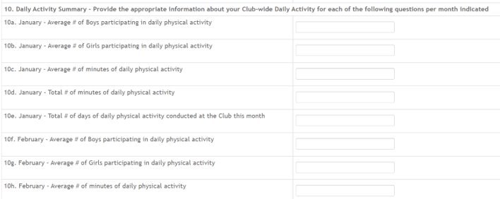
©NCAI 2023
Physical Activity Logs
Question 10. Daily Activity Summary​
You will only enter the summary data for each month, not the daily data as you have in the past.
Notes:
Lisa
The Daily Activity Summary has changed from providing daily information to monthly. You still collect the daily data, however, the spreadsheets provided will allow you to provide the summary of the data for each month.

Slide 33
©NCAI 2023
Data Tracking Spreadsheet
Youth-level Data will be tracked outside of the spreadsheet and will be submitted in the aggregate after the curriculum implementation has ended. The data that will be tracked includes:​
  Gender​
  Age​
  Pre- and Post-test Scores​
  Curriculum start and end date​
  Physical Activity Challenge data (tentatively)
Notes:
LISA​
The spreadsheet for tracking youth level data will be sent with the email after this webinar. ​
The data shown on this slide indicates what will be tracked in that sheet. ​
As mentioned before we are working on possibly adapting the Physical Activity Challenges, but this form will also track youth improvement in these challenges if appropriate.

Slide 34
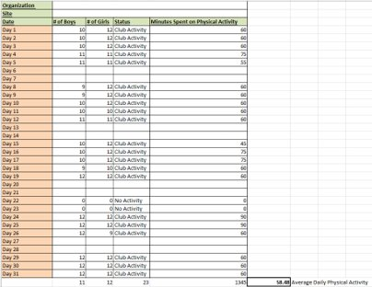
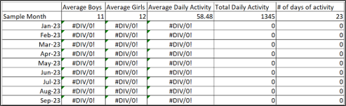
©NCAI 2023
Data Tracking Spreadsheet
Question 10. Daily Activity Summary​
You will only enter the summary data for each month, not the daily data as you have in the past.
We have created a spreadsheet with tabs for each month for you to track the Club-wide daily physical activity. The first tab of the spreadsheet will auto-calculate the totals required for the online reporting site.
Notes:
Lisa
We provided the Daily Activity Summary spreadsheet (screen shot of each are on the screen) to be capture the information to answer questions 10. Please let us know if you need any technical assistance with this. The summary includes the total number of days TRAIL was implemented and the average number of minutes daily.
NEXT SLIDE

Slide 35

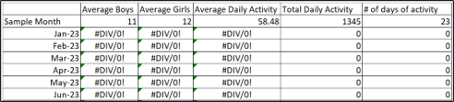
©NCAI 2023
Program Reporting
Notes:
LISA ​
​Also on question 10, the averages from the spreadsheets will be very helpful to answer this activity conducted in the clubs.

Slide 36
©NCAI 2023
Quarterly Program Report
Implementation Tab​
​
You will only enter data into this tab if you completed the T.R.A.I.L. curriculum implementation during this reporting period. ​
If T.R.A.I.L. curriculum implementation spanned two reporting periods, wait until the latter period to report on the Implementation Tab.
Notes:
LISA ​
​Again, at this point you should be completing the implementation tab.
Reminder-only include the information in the quarterly report immediately following the end of your implementation.

Slide 37
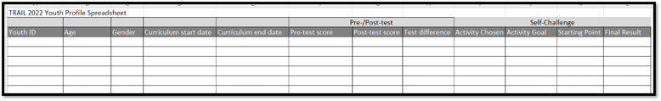
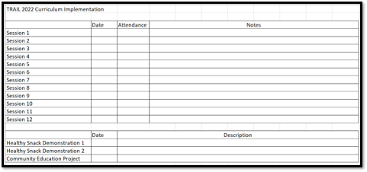
©NCAI 2023
Quarterly Program Report
Implementation Tab
You are not required to use this spreadsheet to track participation and data, however you must have this information saved on file to back up the summary data you submit through the online reporting site.
You are not required to use this spreadsheet to track participation and data, however you must have this information saved on file to back up the summary data you submit through the online reporting site.
Notes:
LISA
On the Implementation tab:
The sheets that were provided in earlier months of TRAIL are very helpful collecting the data to answer the questions. These are screenshots of the spreadsheets.
You are not required to use these spreadsheets but they are created to capture everything necessary to answer the questions on the implementation tab.

Slide 38
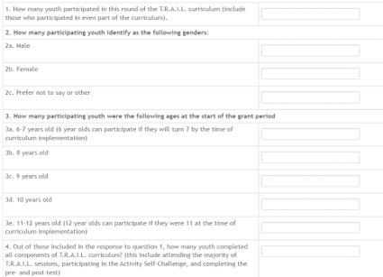
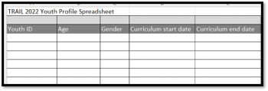
©NCAI 2023
Quarterly Program Report
Implementation Tab
You will complete questions 1-4 on the Implementation tab using the information tracked on the Youth Profile Spreadsheet.
Notes:
LISA ​
​The screen shots of the Implementation tab are best answered with the spreadsheets provided. Keep in mind they are tracking attendance, the number of participants, and youth profile information.
NEXT SLIDE

Slide 39
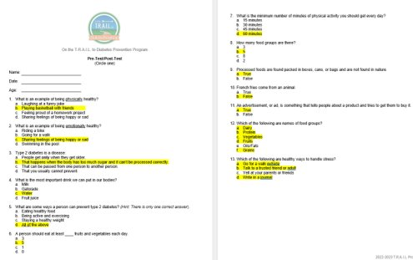
©NCAI 2023
Quarterly Program Report
Pre and Post test​
Only for youth who participate in the curriculum implementation (required youth from your LOA)​
Sheet has total of 13 questions with 19 total options to answer​
Pretest score= #/19​
Post test score = #/19​
Average Group Pre-Test Score = Total combined test scores divided by the total number of participants
Notes:
LISA ​
​

Slide 40
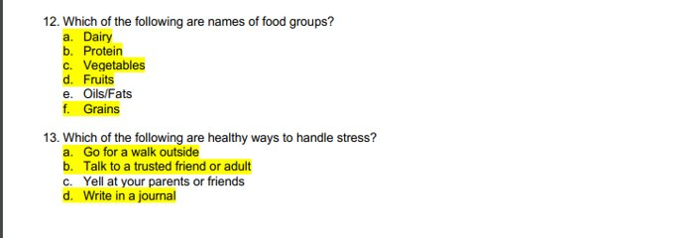
©NCAI 2023
Quarterly Program Report
Implementation Tab – Pre- and Post Test
Notes:
LISA ​
​These are screen shots of the Pre and post tests that the TRAIL participants will complete before the TRAIL curriculum is implemented and after the TRAIL curriculum is implemented
If you have completed the post tests, your TRAIL participants can take them this week .
Instructions for scoring:
There are 13 questions total. However, there are 19 possible points based on questions 12 and 13.
If you see a trend with youth only selecting one answer per question for 12 and 13; then use the total 13.
IF you see a trend with your youth selecting more than one answer, then you can use total of 19.
Example. John picked a, b and d for question 13. So John got 3/5 point for question 13.
I know this is a new process to take on and if you need more help or clarification, I'm here to help. Reach out to me directly.

Slide 41

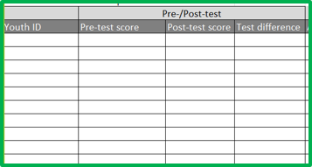

©NCAI 2023
Quarterly Program Report
You will only include the average score for all participants from the pre- and post-test on the online report (questions 5a and 5b)​
You will also have to calculate the difference for each youth [post-test score minus pre-test score]. Take the average across all youth and provide that average for question 5c on the online report.
Notes:
LISA ​
​Identify each box with color
The Blue box is the screen shot of the actual questions in the portal.-here you are Inputting the pre/post test scores on questions 5a-c. The Green box is a screenshot of the excel spreadsheet we provided to capture the data collected of the pre and post test scores. After all of the data is input in the greenbox, you will highlight the each column use the icon pointed out in the Red box, (This Funny E under the blue arrow) that can be found at the top of the excel spreadsheet. This will give you the average for all three columns necessary for the questions shown.

Slide 42
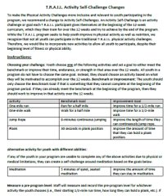
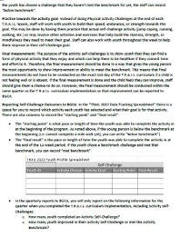
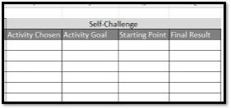
©NCAI 2023
Quarterly Program Report
In the data tracking spreadsheet you will enter the Self-Challenge activity for each youth (one-mile run, one-mile walk, jump rope, or plank), the goal for each youth (benchmark or improvement goal), the starting point (time at the beginning of the T.R.A.I.L. implementation period), and final result (time at the end of the T.R.A.I.L. implementation period)
Notes:
LISA ​
​Activity Self-Challenge.
Choosing your challenge: Youth choose one of the following activities and set a goal to either meet the benchmark or improve their time, endurance, or strength in that area over the 12 weeks. All youth in a program do not have to choose the same goal. Instead, they should choose an activity based on what they will be motivated to accomplish over the 12 weeks.
The examples are provided, we are putting this same handout in the chat but it is also on our naclubs.org resource page.
The screen shot of the data tracking spreadsheet is provided on the slide. In the data tracking spreadsheet you will enter the Self-Challenge activity for each youth (one-mile run, one-mile walk, jump rope, or plank), the goal for each youth (benchmark or improvement goal), the starting point (time at the beginning of the T.R.A.I.L. implementation period), and final result (time at the end of the T.R.A.I.L. implementation period)
NEXT SLIDE

Slide 43
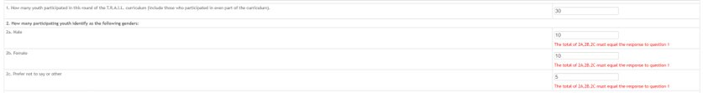

©NCAI 2023
Quarterly Program Report
Notes:
LISA ​
​The new portal site has allowed validations to answering some items on the implementation tab. The main thing is, we want to make sure each number provided is accurate based on the information you initially answer i.e. if there are 25 participants-it won't allow you to enter 10 boys and 10 girls. The incorrect response will be in red at the bottom of each incorrect piece that is entered.
NEXT SLIDE

Slide 44
©NCAI 2023
Quarterly Program Report
The number entered isn't correct, it will have in red under the answer in questions​
A short explanation will also help you to entering the correct amount​
You won't be able to continue until the amount is corrected
Notes:
LISA ​
​Read bullets on the slide
Again, the portal has a new feature that will highlight incorrect responses in red and won't allow you to continue until the number is correct.

Slide 45

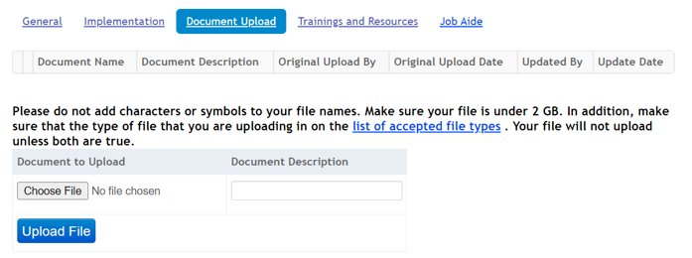
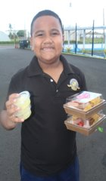
©NCAI 2023
Program Photos
Submit program photos.​
Secure photo permissions
Notes:
LISA ​
​Document upload is here if you like to provide pictures or any piece of information that you feel would be helpful in the reporting period.
A picture is worth a thousand words, we want to see how your TRAIL program as it comes to life.​
The cool thing is you can now upload them into your reporting system much like OJJDP. Its super easy.
NEXT SLIDE

Slide 46
©NCAI 2023
Training Doesn’t Stop Here​
Support is available throughout the grant year​
  General questions​
  Program guidance​
  Guidance on allowable expenses
Notes:
LISA​
Support is available throughout the grant year​
Do not hesitate to reach out to us if there are additional questions or you would like more information about any part of the program.​
We are here to help. ​
Also remember your network of TRAIL clubs on this call. You all are a wealth knowledge and can easily support one another

Slide 47
©NCAI 2023
Update to naclubs.org
The T.R.A.I.L. Resource Center is being updated on naclubs.org​
https://naclubs.org/trail-resources/ ​
​
It is now under the Resources tab ​
​
NEW PASSWORD IS: ​
DrinkMoreWater
Notes:
LISA ​
We are reworking the naclubs.org TRAIL resource page. ​
There are limited resources posted right now, however the full curriculum is still available as well as the Budget Form and Contact Form. ​
We will be adding new resources. The password to life is Drink More Water which is also the password to the TRAIL resource center.

Slide 48

©NCAI 2023
Notes:
LISA​
We've covered a lot of information. If there are any questions, please share in the chat.​
​
After the questions are complete ​
​
Thank you all so much and I look forward to working with you ​
​
Please welcome back, National Vice President, Carla Knapp to close us out

Slide 49
©NCAI 2023
Boys & Girls Clubs of America ​
Angela Caffee acaffee@bgca.org​
Carla Knapp cknapp@bgca.org​
​
National Congress of American Indians​
Lisa Vandever lvandever@ncai.org
Notes:
Carla ​
Read the slide ​
Again, here is the contact information should you need any assistance on your TRAIL journey ​
We are here to support you

Slide 50
Thank you for your participation
©NCAI 2023
Notes:
Carla Closing Remarks

