Slide 1



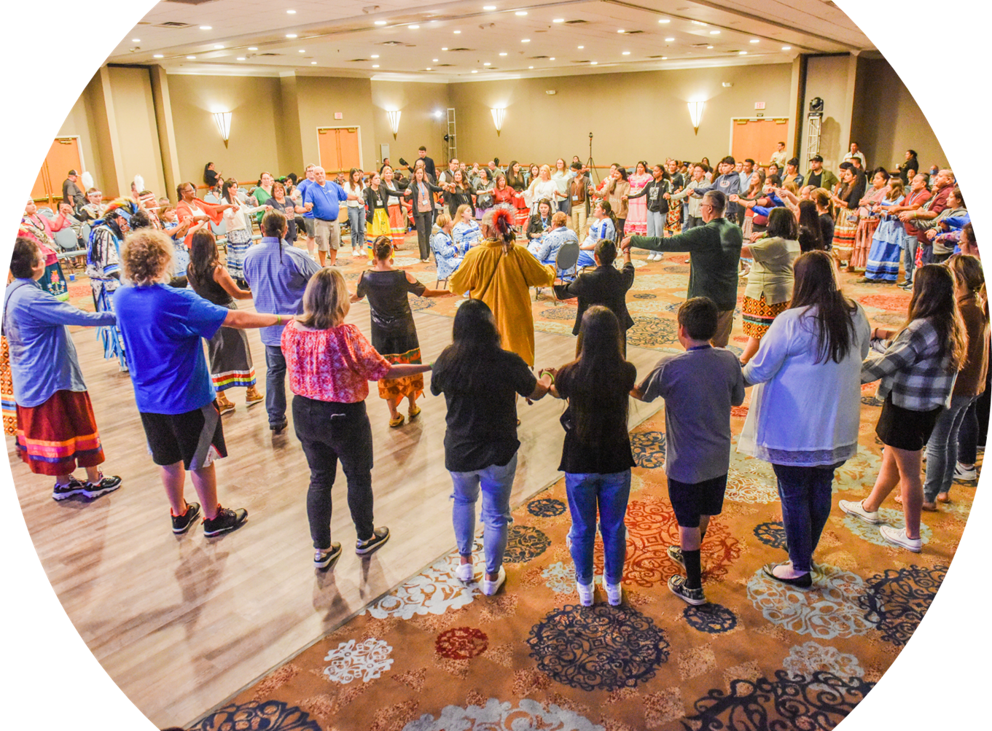

Welcome!
Notes:
No cameras
Round dance photo in background as people arrive
Norma - Housekeeping
Hello, and thank you for joining us today. This is Norma Brown, your Zoom coordinator.
Before we begin, there are a few housekeeping items for our time together. All participants are not muted so please press the Mute button until you are ready to speak. I encourage you to share your comments in the Chat Box, and we will go over them during our broadcast.
With that, I’d like to introduce Carla Knapp, National Vice President for Native Services, joining us today to begin today’s mandatory TRAIL session, Program Overview and Reporting.
Carla, I’m turning this over to you!

Slide 2

T.R.A.I.L. New Grantee Webinar
October, 2023
Notes:
Carla​
​
Thank you Norma and welcome everyone to our third training TRAIL 2023 New Grantee webinar and congratulations on your grant award.......we hope that you enjoy the last two trainings and the next 60 minutes together and find the informational valuable as you begin to implement your TRAIL program. And as shared on the previous calls, we are in this together, program implementation, grant reporting are going to be critical to our success together. ​
Now I would like to turn it over to our Senior Director of Federal Grants Impact and Performance Kelly Crowe
​
Next slide....
​

Slide 3
Training Objectives
Provide clarity around grant components and implementation
Hear from existing grantees about best practices
Respond to questions that have arisen for new grantees during the past two trainings this week
Notes:
Kelly:
Thank you Carla. Today’s webinar will be less of a presentation than a discussion (hopefully). We will start with clarifying the grant components and implementation strategies for a successful grant. We will then request that our grantees from the past years share some best practices to support new grantees. Finally, we will hear from new grantees about any questions that have arisen for them over the past two trainings.

Slide 4
T.R.A.I.L. 2023 Components
Finance | Club-wide activities | Curriculum Implementation
Create a budget and have it approved | Track 60 min. of daily physical activity for all Club members | Conduct the 12-session curriculum for the number of youth in your LOA
Purchase equipment relevant to program implementation | Implement two healthy snack demonstrations for the Club | Conduct pre- and post-tests for all youth participating in the curriculum
Submit regular reimbursement requests – bi-monthly | Conduct an annual Community Education Project | Have all youth participating in the curriculum complete a Self-Challenge Activity
Track spending against the budget | Report on activities quarterly | Report on outcomes during the quarterly report after you have completed implementation

Slide 5
Possible Best Practices
T.R.A.I.L. Implementation cycles – single or multiple
Using community resources and partnerships to support implementation
Purchase supplies early in the grant cycle
Use the resources on naclubs.org to easily track program data
Notes:
Clubs can split the youth into multiple cohorts and run multiple 12-week implementation cycles (i.e. once Q2 and once in Q4)
Connect with community partners such as health services, elders, etc. to have them provide training for staff, guest speakers for youth, participation in healthy snack demonstrations, or physical/recreational activities
Purchase supplies outlined in the budget at the beginning of the grant so they can be used for the programs. If you wait until the end of the grant, you may not be able to purchase the supplies since they won’t have relevance to program implementation

Slide 6
Sample Timeline
October 1-December 31, 2023
January 1-March 31, 2024
April 1-June 30, 2024
July 1-September 30, 2024
Participate in orientation webinars
Complete budget and receive approval and submit at least one financial reimbursement request
Conduct 60 minutes of daily physical activity and track youth participation
Integrate healthy choices and cultural/traditional practices into daily Club activities
Train Club staff on T.R.A.I.L. curriculum implementation and identify youth to participate
Submit a quarterly program report (general tab)
Submit at least two financial reimbursement requests
Conduct 60 minutes of daily physical activity and track youth participation
Integrate healthy choices and cultural/traditional practices into daily Club activities
Begin implementation of T.R.A.I.L. curriculum
  Conduct pre-tests for all youth participants
  Have each youth select a Self-Challenge Activity goal
Submit a quarterly program report (general tab)
Complete a healthy snack demonstration
Submit at least two financial reimbursement requests
Conduct 60 minutes of daily physical activity and track youth participation
Integrate healthy choices and cultural/traditional practices into daily Club activities
Complete implementation of T.R.A.I.L. curriculum
  Conduct post-tests for all youth participants
  Have each youth complete their Self-Challenge Activity goal
Submit a quarterly program report (general and implementation tab)
Submit at least two financial reimbursement requests
Conduct 60 minutes of daily physical activity and track youth participation
Integrate healthy choices and cultural/traditional practices into daily Club activities
Complete a healthy snack demonstration
Conduct Community Education Project
Notes:
This is only a sample as Clubs can decide when they want to run the various components of the program.

Slide 7
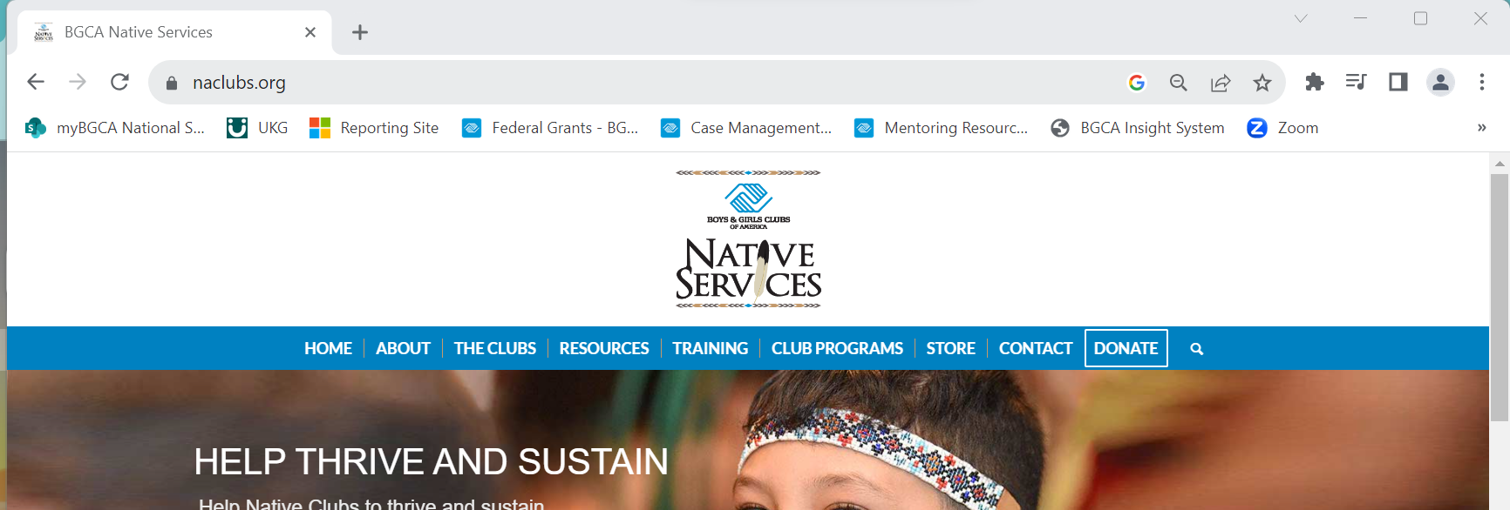
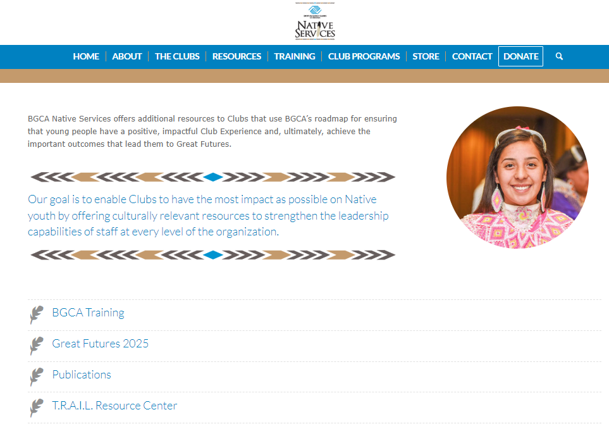
Naclubs.org
Go to naclubs.org
Select the Resources tab and click on T.R.A.I.L. Resource Center from the dropdown list or on the Resources page as seen to the right

Slide 8
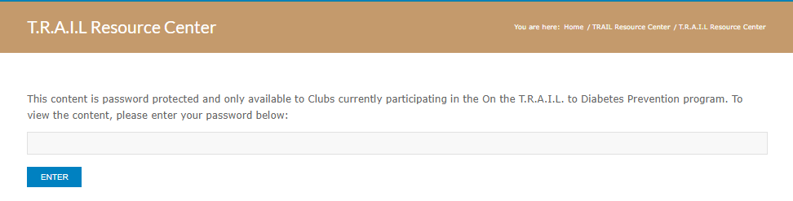

Naclubs.org
DrinkMoreWater
Enter the password: DrinkMoreWater
Select Program & Finance on the following page
Other resources that can be found on this page are:
  The electronic version of the curriculum
  Recordings of the training webinars
  A link to the online reporting site
  Other resources to support implementation
  Safety resources around COVID-19

Slide 9
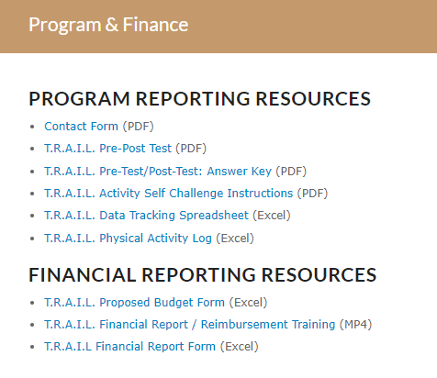
Naclubs.org
Contact Form: This will be updated to an online contact management system. More information will be provided.
Pre- and Post-test:
Lisa reviewed how to conduct and score the pre- and post-test on the previous webinar which will be posted on naclubs.org
Activity Self-Challenge Instructions: These instructions will explain how to conduct the Activity Self- Challenge. Details on implementation can be found in the TRAIL Program Overview and Reporting webinar conducted yesterday
Data Tracking Spreadsheet: This spreadsheet will allow you to track the data and will help you calculate responses for the quarterly program reports
Physical Activity Log: This spreadsheet should be used to track the Club-wide daily physical activity and will auto-calculate the responses for the quarterly program reports

Slide 10
Other Best Practices?
Admin:
Use the orientation trainings for new staff when they join
Build a succession plan around TRAIL in case of turnover
Request a consultation with BGCA for your whole TRAIL team
Engage Tribal staff early to help understand the requirements of the grant
Use the spreadsheets to track program data
Submit reimbursements monthly to keep a steady cashflow
Club-wide Activities:
Continue to submit healthy snacks over and over, not just once
Incorporate existing cooking demonstrations into the TRAIL program
Partner with the local extension office on healthy snack demonstrations
Curriculum Activities:
Notes:
.

Slide 11


Slide 12
Boys & Girls Clubs of America ​
Angela Caffee acaffee@bgca.org​
Carla Knapp cknapp@bgca.org​
​
National Congress of American Indians​
Lisa Vandever lvandever@ncai.org

Slide 13
Thank you for your participation
©NCAI 2023
Notes:
Carla Closing Remarks

