Slide 1



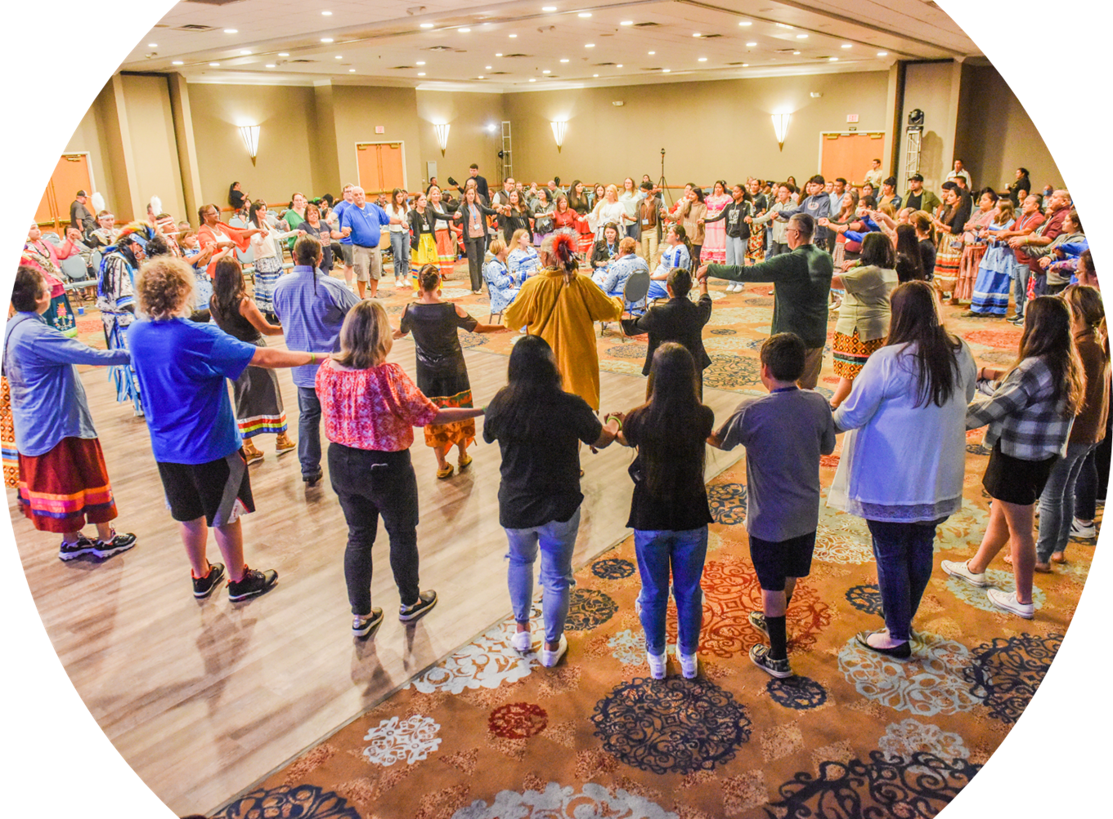

Welcome!
©NCAI 2023
Notes:
Norma ​
​Housekeeping ​
​Turn over to BGCA NVP Native Services Carla Knapp​
​

Slide 2

T.R.A.I.L. Overview, Activation, and Budget Development October, 2023
Notes:
Carla​
​
Thank you Norma and welcome everyone to our second training TRAIL 2023 Program Data Tracking and Reporting.......we hope that you enjoy the next 60 minutes together and find the informational valuable as you begin to implement your TRAIL program. ​
​
Next slide....
​

Slide 3





National Partners
©NCAI 2023
Notes:
Carla​
​
And before we begin, I want to acknowledge and recognized our amazing partners......through the support of Indian Health Services, BGCA and NCAI have partnered directly together to support you and your TRAIL program.​ I can't stress enough how excited we truly are and look forward to an amazing year and working with you in partnership.​
​I also hope that some of the changes we have made will make this easier for you and very streamlined.
So lets get this started.......it is an honor and a privilege to introduce our first presenter......Please welcome our very own, BGCA Native Services Director of Organizational Development Anna Bear to take more about the curriculum.

Slide 4
Training Objectives
©NCAI 2023
To understand the framework and purpose of T.R.A.I.L.​
  Curriculum and Implementation​
  Progress Reports​
  Physical Activity Logs​
  Pre- and Post-tests​
To network, make connections, and learn from each other
Notes:
Lisa
Thank you Carla ​
The training objectives for today are ​
To understand the framework and purpose of T.R.A.I.L.​
Curriculum and Implementation​
Progress Reports​
Physical Activity Logs​
Pre- and Post-tests​
Physical Activity Challenge Tracking​
Implementation Plans (New)​
To network, make connections, and learn from each other

Slide 5
Required Trainings
Please note that you must have a representative from your Organization on both this and tomorrow's mandatory meetings, as well as the Thursday webinar if you are a new grantee this year.
Today's Webinar - T.R.A.I.L. Overview, Activation, and Budget Development on October 17, 2023, from 1:00 pm – 2:00 pm EST.
Mandatory - T.R.A.I.L. Program Data Tracking and Reporting on October 18, 2023, from 1:00– 2:00 pm EST.
REGISTER HERE
Mandatory – New Grantees on October 19, 2023, from 1:00– 2:00 pm EST.
REGISTER HERE
Additional Trainings on Reimbursement Request/Financial Report development and Quarterly Program Reporting will be provided throughout the grant year. Please watch your email for announcements of upcoming webinars.

Slide 6

©NCAI 2023
Training Objectives
Key Dates
Activating Your Federal Grant
Budget Development
  Federal Grant Budget Proposal Form
  Standard Proposal Budget Questions
  Common Proposed Budget Errors
Notes for T.R.A.I.L 2023

Slide 7
©NCAI 2023
Key Dates
Letter of Agreement (LOAs) issued to clubs on September 29, 2023.
LOAs are to be returned 45 (actual) days following receipt.
Grant year began October 1, 2023 and ends on September 29, 2024.
Notes:
- LOAs are to be returned to the Federal Grants Department by November 14th, 2023 (if received on 9/29/2023).

Slide 8
©NCAI 2023
Activating Your Federal Grant
Review your Letter of Agreement (LOA) carefully before obtaining the required initials and signatures. If you have concerns about meeting the requirements of the grant, please contact your assigned BGCA Director of Organizational Development (DoD).
If you agree to the requirements, the Chief Executive Officer and a second signatory (SS) must initial each requirement, sign and date the LOA.
The following items must be returned to the Federal Grants Department for each grant:
  The signed Letter of Agreement
  All required certification forms, accurately completed, signed and dated
  A completed proposed budget, signed and dated
Notes:
- Second SS may be your Board Chari or someone from the tribe legally allowed to enter into agreements on behalf of the club. This person will be CC’d at the bottom of the LOA. Any questions, let your DOD know to adjust.

Slide 9
©NCAI 2023
Activating Your Federal Grant
The executed and completed Letter of Agreement, certification forms and proposed budget must be submitted by email to: TRAIL@bgca.org
Once the LOA and supporting documentation are received by the Federal Grants Department, they will be reviewed by the Federal Grants T.R.A.I.L team.
Federal Grants T.R.A.I.L team will contact you via phone and/or email if there are questions concerning your LOA, certifications and/or proposed budget.
Notes:
.

Slide 10
©NCAI 2023
Activating Your Federal Grant
Common LOA errors/delays in grant activation include:
  CEO or Board Chair has changed and BGCA has not been updated; be sure to provide your assigned BGCA Director of Organizational Development updated information
  Missing initials or signatures
  Missing information; all required information should be completed
  Missing certifications; all 10 certifications must be submitted
  LOA was not returned within 45 days as required
Notes:
. Talk about looking through each section of certifications and checking off the boxes.

Slide 11
©NCAI 2023
Activating Your Federal Grant
Once all documents, including the proposed budget, are approved, you will be notified by email that your grant has been activated.
After receiving the grant activation email, your organization is authorized to begin submitting reimbursements/financial reports and drawing down grant funds (unless you have a funding HOLD).
Funds are released on a reimbursement basis only.

Slide 12
Budget Develpment
Notes:
​

Slide 13
©NCAI 2023
Federal Grant Budget
Proposal Form
The Budget Proposal Form is included in the (sub) grant Letter of Agreement (LOA).
Budget proposals are to be completed for the full grant term (October 1, 2023 to September 29, 2024) based on the effort possible within the (signed) LOA return timeframe.
Budget revisions may be submitted later – however, not all proposed changes or retroactive revisions will be acceptable or accommodated.
Notes:
We are working to identify a way for them to use trail fund to send trail coordinator to trail summit. Protonate on the persons charged to grant as well as portion of their time related to TRAIL at the summit. There will be a track to follow for TRAIL trainings. More to come within the next few weeks. Add placeholder to Budget, can adjust later.

Slide 14
©NCAI 2023

Slide 15
©NCAI 2023
Standard Proposal
Budget Questions
Questions to ask:
Gross Salary & Benefits (A&B): Do/Will the positions being charged to the grant work the % of time listed on grant-related TRAIL activity and at the funded site?
  What % of salaries should I be charging?
  Answer - The % of time charged to the grant must be the % of actual time that you estimate the position(s) will be working to satisfy the grant requirements as outlined in the LOA. While you can use an estimated % of time for the proposed budget, on financial reports you must use the actual % of time spent on grant-related activity as documented on the employee(s) activity reports (timesheets) regardless of the % initially budgeted.
Notes:
Angie:
How are you feeling about preparing your Budget proposal Forms?
The next few slides will assist you in the development of your Budget Proposals as we have prepared a list of questions you may ask yourself to help you progress throughout the development of your Budget Proposal Form.

Slide 16
©NCAI 2023
Standard Proposal
Budget Questions
Questions to ask (continued):
Contracted/Consulting Services (C): Do/Will the contractors/consultants charged to the grant have responsibilities that are directly related to TRAIL activities. Can a copy of the contract and detailed dated, itemized invoices be provided during the reimbursement process and is the consultant’s rate below the maximum $81.25/hour ($650/8 hour day)?
Travel (D); Equipment/Software (E); Supplies (F); Building Costs (G); Telephone (H); Postage (I); and Other (J): Are all expenses being charged to the grant solely for the funded site and are they necessary to meet the TRAIL grant requirements as outlined in the LOA?

Slide 17
©NCAI 2023
Standard Proposal
Budget Questions
Questions to ask (continued):
Do/Will copies of contracts, rent/lease agreements, verification of service dates, or other pertinent information be available.
If indirect costs are being charged, do/will I verification that no duplicate administrative or facilities costs are being charged to the grant as direct costs.
  Who do I contact if I have concerns about my Club meeting the grant requirements as outlined in the LOA?
    Answer - Contact your BGCA Director of Organizational Development (DOD) to discuss your concerns.

Slide 18
©NCAI 2023
Pre-approved Supplies Expenses
for TRAIL- Amazon List
Amazon List of supplies items that Clubs can purchase (alternatives can be purchased through approval from Angie)
Example Items:
Jumps Ropes
Yoga mats
Native cook books
Kids nutritional books
Amazon List Link

Slide 19
©NCAI 2023
Common Proposed
Budget Errors
Errors/delays in grant activation include:
  Budget is not submitted on correct proposed budget form
  Budget is not signed and dated by CEO
  Budget includes unallowable items; a list of allowable expenses will be provided.
  Amount budgeted is higher or lower than the grant award amount. Budgets should total exact awarded amount.
  Missing information - Please be sure to include all information that is required in each line item, including descriptions and % justification where noted
  Please note that there is no requirement to charge items in every line item

Slide 20
©NCAI 2023
Notes for T.R.A.I.L 2023
Healthy Snacks are an allowable Cost and Should Be Charged to T.R.A.I.L 2023 Grants
  Different from OJJDP, healthy snacks and supplies necessary to implement the T.R.A.I.L. Program and curriculum are considered an allowable cost.
Refer to the Healthy Snack Guidance document in the T.R.A.I.L. Resource Center on BGCA.net under the native Services Tab.
.

Slide 21

©NCAI 2023

Slide 22
©NCAI 2023
Boys & Girls Clubs of America ​
Angela Caffee acaffee@bgca.org​
Carla Knapp cknapp@bgca.org​
​
National Congress of American Indians​
Lisa Vandever lvandever@ncai.org

Slide 23
Thank you for your participation
©NCAI 2023
Notes:
Carla Closing Remarks

